Slide 1
SWIGGY RECOMMENDATION MODEL

Slide 2
A PROJECT BY :-
Manikanta Bojja
Manpreet Singh
Sai Eswar R
Yasmeen Ustad

Slide 3
INTRODUCTION
Swiggy is an Indian online food ordering and delivery platform. Founded in 2014, Swiggy is headquartered in Bangalore and operates in more than 500 Indian cities.
Besides food delivery, the platform also provides on-demand grocery deliveries under the name Instamart, and same-day package delivery service called Swiggy Genie.
It rivals homegrown startup Zomato in food delivery and hyper local marketplace.

Slide 4
OBJECTIVES
Developing a recommendation model based on scraped data from Swiggy and make a webpage of it.
Design algorithms analyzing user data to generate personalized recommendations based on past ratings, cuisine preferences, and location.
Enabling users to access information about cuisine availability at different restaurants and preferred price ranges.
Develop user-friendly interface for feedback, enabling users to explore menus, reviews, and ratings of recommended restaurants
Assisting potential restaurant owners in determining optimal cuisine offerings and average pricing for new restaurant ventures.

Slide 5
PURPOSE
Provides personalized restaurant recommendations to users based on their preferences and needs.
Encourage users to explore and try new restaurants, leading to increased business for restaurant partners.
Reduce the time and effort required for users to discover new dining options.
Simplify the process of finding and selecting restaurants for users.
Empowers restaurateurs with data-driven recommendations.
To increase user satisfaction and engagement with the platform.
Aligns offerings with customer preferences and market trends.
Access to insights for success in a competitive industry.

Slide 6
DATA PROCESSING TECHNIQUES
Handling Missing Values
Changing Data Types
EXCEL Formulae(Left,Right,Trim,Proper,Right)
Removing or Correcting Any Errors
Scaling
Encoding Categorcal Columns.

Slide 7
MACHINE LEARNING
Linear Regression - To predict Recommended Price for 1.
Random Forest- To predict Recommended Location.
Accuracy Score for Random Forest Model has been found around 98 %, whereas that of Logistic Regression Model has been found around 13%.
To avoid Biasness of the Output, Scaling with Min Max Scaler has been performed on features.
In order to convert Categorical values in the data to Continuous, Label Encoder and One-hot encoder has been used for encoding purpose.

Slide 8
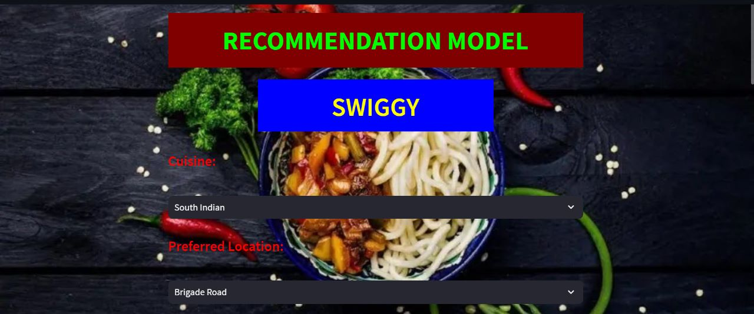
INPUT

Slide 9
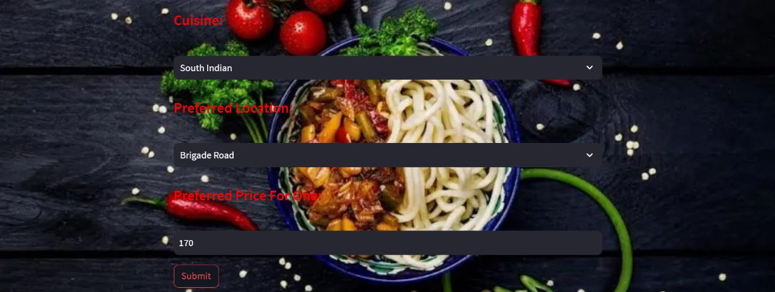

Slide 10
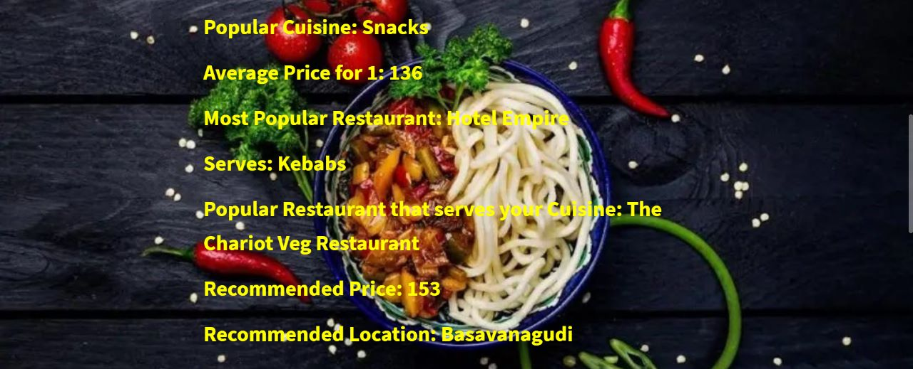
FINDINGS

Slide 11

FEEDBACK

Slide 12
LIMITATIONS AND FUTURE WORK
Not enough data about users or items, making it difficult to give accurate recommendations.
Extracting data from Alternate data sources
Struggle with updates in real-time, like new user preferences or changing item availability.
Adapt and update recommendations in real time.
Make recommendations more understandable and transparent.
Build trust and understanding and take user feedback into account
Not enough information about certain items, especially those that are not popular or niche.
Fill missing values by analyzing patterns in user-item interactions to estimate the unknown values.

Slide 13
CHALLENGES
Converting numerical values to categorical outputs in the machine learning.
Styling web page elements include applying background color and text color.
Build interactive web page directly from Python scripts.

Slide 14
LEARNING OUTCOMES
Stream lit python library
Deploy Machine Learning Model in Webpage
Basic Knowledge of CSS
Basic Knowledge of HTML tag
Scraping data from Websites
Time Management
Team Work and Coordination

Slide 15
Thank You

